Slide 1
DVP Information Model (Conceptual) v0.5 Draft

Slide 2
1. Overview
Content
2. Capability views
3. DVP Sub Domains

Slide 3
DVP BOTTOM UP DOMAINS EXAMPLE
Information Domains per Application with Dependencies | Version: | 0.5 | Author: | Hans Westman | Last modified: | 2014-06-10
Draft! Not complete.

Slide 4
DVP CONCEPTUAL INFORMATION MODEL – BIG CHART 1
Conceptual Information Model | Version: | 0.5 | Author: | Hans Westman | Last modified: | 2014-06-10
Draft! Not complete.

Slide 5
DVP CONCEPTUAL INFORMATION MODEL – BIG CHART 2 (ESW)
Conceptual Information Model | Version: | 0.5 | Author: | Hans Westman | Last modified: | 2014-06-10
Draft! Not complete.

Slide 6
1. Overview
Content
2. Capability views
3. DVP Sub Domains

Slide 7
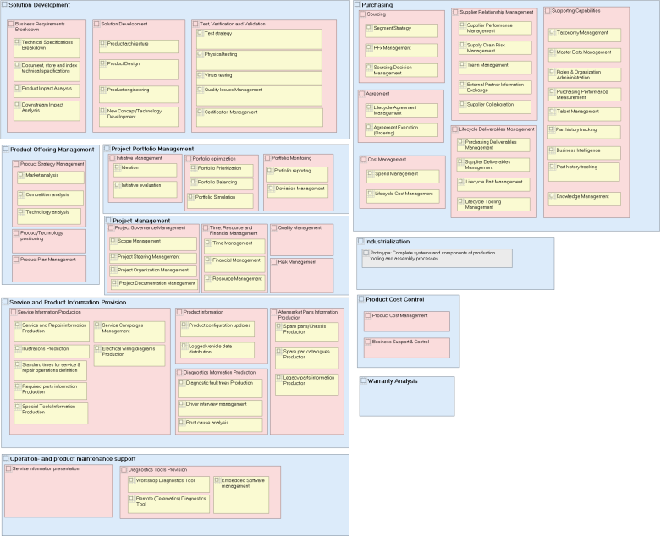
DVP BUSINESS CAPABILITIES
Conceptual Information Model | Version: | 2.0 DRAFT | Author: | Emeric Nectoux | Last modified: | 2014-10-29
Draft version 2 beta 2014-10-29

Slide 8
Example: Information objects / capability (via applications)
Develop and Industialize Solution
Prototype Mgmt
Pre-Prod Procurement
Prototype Material – Conceptual Information Model
Prototype Material
GLORIA
Prototype Warehouse
GLORIA

Slide 9
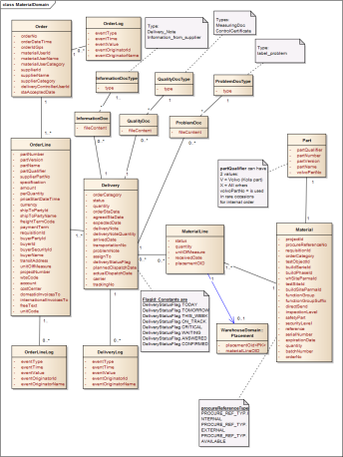
Example: Database objects / capability (via applications)
Develop and Industialize Solution
Prototype Material –
DB Information Model
Prototype Mgmt
GLORIA
Pre-Prod Procurement
Prototype Material
Prototype Warehouse

Slide 10
1. Overview
Content
2. Capability views
3. DVP Sub Domains

Slide 11
PROJECT SCHEDULING - Conceptual Information model
Conceptual Information model | Version: | 0.5 | Author: | Hans Westman | Last modified: | 2014-06-10

Slide 12
TEST OBJECT MANAGEMENT - Conceptual Information model
Conceptual Information model | Version: | 0.5 | Author: | Hans Westman | Last modified: | 2014-06-10

Slide 13
ITEM TO VARIANT - Conceptual Information model
Conceptual Information model | Version: | 0.5 | Author: | Hans Westman | Last modified: | 2014-06-10

Slide 14
PROTOTYPE WAREHOUSE - Conceptual Information model
Conceptual Information model | Version: | 0.5 | Author: | Hans Westman | Last modified: | 2014-06-10

Slide 15
PROTOTYPE MATERIAL - Conceptual Information model
Conceptual Information model | Version: | 0.5 | Author: | Hans Westman | Last modified: | 2014-06-10

Slide 16
PRE-PROD PROCUREMENT - Conceptual Information model
Conceptual Information model | Version: | 0.5 | Author: | Hans Westman | Last modified: | 2014-06-10

Slide 17
PRODUCT CERTIFICATION - Conceptual Information model
Conceptual Information model | Version: | 0.5 | Author: | Hans Westman | Last modified: | 2014-06-10

Slide 18
ESW TEA2+ SECURITY CONCEPT - Conceptual Information model
Conceptual Information model | Version: | 0.5 | Author: | Hans Westman | Last modified: | 2014-06-10

Slide 19
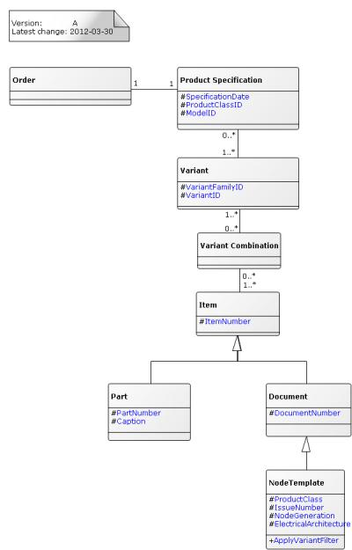
ESW SOFTWARE BREAKDOWN - Conceptual Information model
Conceptual Information model | Version: | 0.5 | Author: | Hans Westman | Last modified: | 2014-06-10

Slide 20
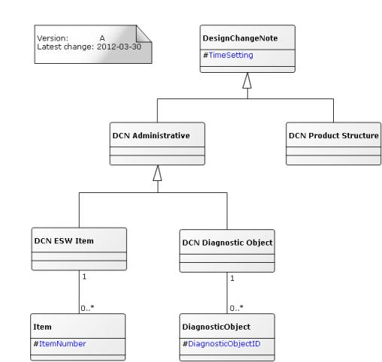
ESW DCN - Conceptual Information model
Conceptual Information model | Version: | 0.5 | Author: | Hans Westman | Last modified: | 2014-06-10

Slide 21
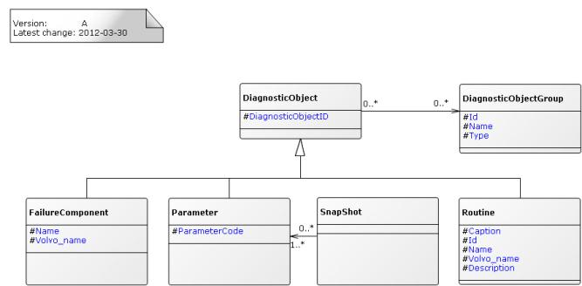
ESW DIAGNOSTIC OBJECT - Conceptual Information model
Conceptual Information model | Version: | 0.5 | Author: | Hans Westman | Last modified: | 2014-06-10

Slide 22
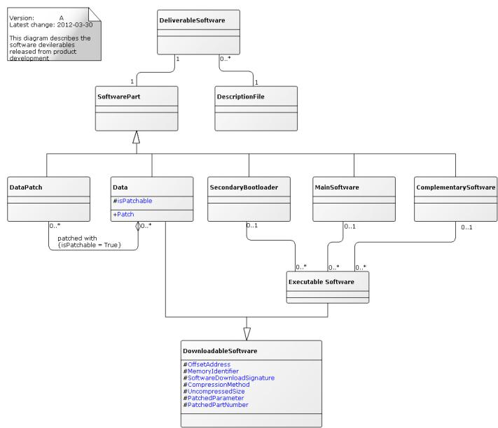
ESW FILES - Conceptual Information model
Conceptual Information model | Version: | 0.5 | Author: | Hans Westman | Last modified: | 2014-06-10

Slide 23
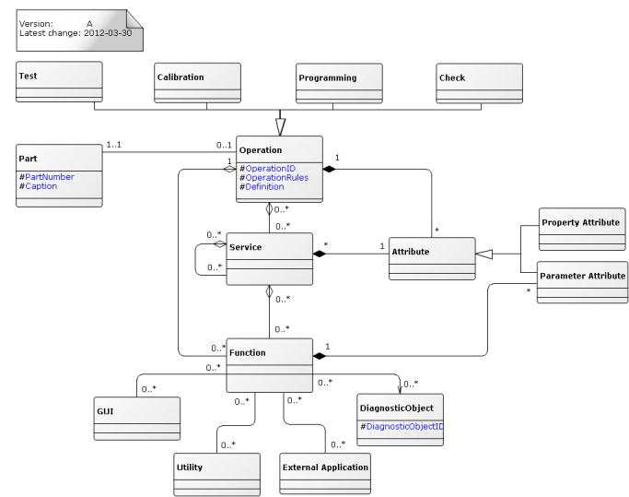
ESW OPERATION - Conceptual Information model
Conceptual Information model | Version: | 0.5 | Author: | Hans Westman | Last modified: | 2014-06-10

Slide 24
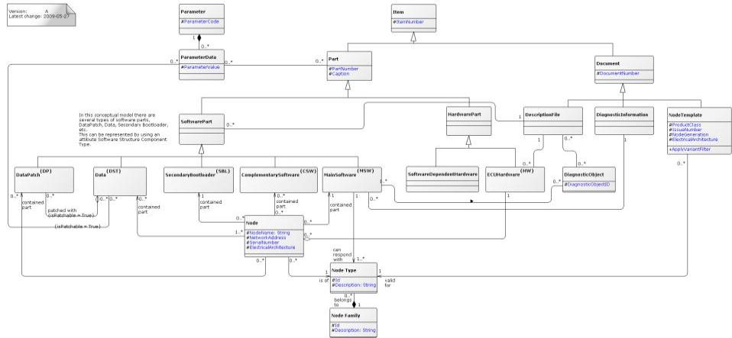
ESW PART- Conceptual Information model
Conceptual Information model | Version: | 0.5 | Author: | Hans Westman | Last modified: | 2014-06-10

Slide 25
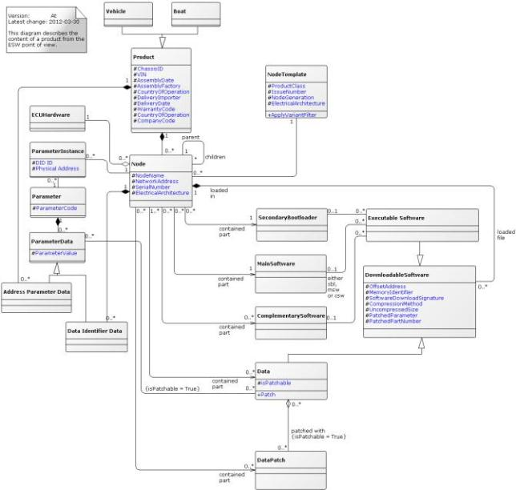
ESW PRODUCT - Conceptual Information model
Conceptual Information model | Version: | 0.5 | Author: | Hans Westman | Last modified: | 2014-06-10

Slide 26
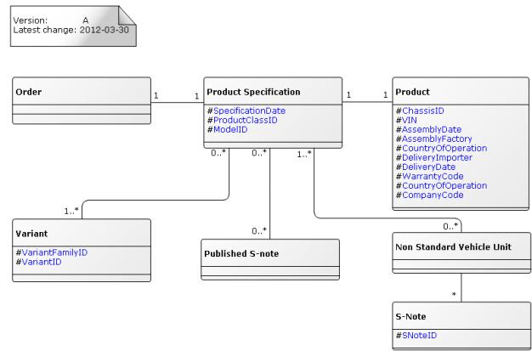
ESW PRODUCT SPECIFICATION - Conceptual Information model
Conceptual Information model | Version: | 0.5 | Author: | Hans Westman | Last modified: | 2014-06-10

Slide 27
View 1 Applications mapped to Capabilities with status coloring
Develop and Industrialize Solution
Validate customer features
Manage Project Portfolios
Purchasing
Product Engineering
Product Engineering
Requirements Management
Product Portfolio Management
Strategic Sourcing
Product Styling & Design
Product Structure & Variant Management
Product Certification
Project Portfolio Management
Supplier Management
Mechanical CAD
Product Technical Specification & Documentation
Simulation & Validation
Project Process Management
Price & Contract Management
Electrical CAD
Product Configuration & Context Management
Requirements Verification
Project Execution Management
Tooling Management
Embedded Software Dev
Product Change Management
Test Systems Management
Resource Management
Requisition & Order Management
CAE
Prototype Management
Cost Management
Quality Management
Multi CAD Data Management
Systems Architecture and Modeling
IP, Security & JV Management
Control Product Cost
Supplier Collaboration
Virtual Product & Context Mgmt
Manage Product Cost
BW & Reporting
Plan Product and Technology
Develop Technologies
Support MAS/DCL & PRD processes
Plan Products/
Technology
DevTechnologies/ Concptets
Provide Service & Product Information
Service &
Repair
Warranty
Analysis

Slide 28
Information objects / capability (via applications)
Develop and Industialize Solution
Prototype Mgmt
GLORIA
Prototype Material – Conceptual Information Model

Slide 29
Document History
Version & Date | Change | Who
2013-11-06 v0.5 | Product Definition, Test Object Management, Certification, Product Cost, Virtual Structure, | Åke Liljenberg, Hans Westman
2013-11-12 v0.2 | Product Scheduling Domain | Hans Westman, Cyrill Cauchy
2013-12-04 v0.3 | ESW sub domain | Hans Westman
2014-01-22 v0.4 | ESW big chart and Security Concept | Hans Westman
2014-10-29 v0.5 | Updated Business Capabilities slide (to draft version 2) | Hans Westman

